Slide 1
3.9. Methods for High Degrees of Similarity
Vo Ngoc Huy Thong

Slide 2
Contents
1
Introduction
2
Finding Identical Items
3
Representing Sets as Strings
4
5
6
7
Length-Based Filtering
Prefix Indexing
Using Position Information
Using Position and Length in Indexes

Slide 3
1. Introduction
Locality-Sensitive Hashing (LSH)
Benefits:
Efficiency: LSH is effective at quickly finding similar items in large datasets, especially when the desired degree of similarity is relatively low.
Speed: It reduces the number of comparisons by grouping potential candidates into buckets, making it faster than exhaustive pairwise comparisons.
Drawbacks:
Not ideal for near-identical sets: When looking for sets that are almost identical, LSH can be less efficient compared to other methods.
Inexact: LSH may produce false negatives, meaning it might miss some similar pairs. It is probabilistic, so it doesn't guarantee finding all similar items​.
When dealing with items that require a high degree of similarity, other exact methods might be more appropriate.

Slide 4
2. Finding Identical Items
To find identical items, such as identical web pages, a straightforward comparison of documents works, but it's inefficient to compare every pair.
Some strategies include:
Hashing based on the first few characters may not work well if many documents share the same prefix, such as an HTML header.
Hashing using the entire document is effective but slow since every character must be examined.
Optimal Approach: fixed random positions within the documents are selected for hashing. This avoids the common-prefix problem and reduces the need for full document comparison.

Slide 5
3. Representing Sets as Strings
Challenge: finding pairs of sets with high Jaccard similarity (e.g., at least 0.9) in large datasets.
Solution: representing sets as strings by sorting their elements in a fixed order.
Two key properties of strings:
No character appears more than once.
Characters appear in the same order across different strings if present.
Example: set {d, a, b} → string abd (alphabetical order).
The Jaccard similarity of the sets can be discussed using these string representations.

Slide 6
4. Length-Based Filtering
The simplest way to exploit the string representation of previous section is to sort the strings by length.
Suppose:
Two strings, s and t, represent two sets
Ls​ is the length of string s, and Lt​ is the length of string t
Ls ≤ Lt
J is the lower bound for Jaccard similarity between the two strings
For a comparison, the length of t must satisfy: Lt ≤ Ls/J
This ensures that only pairs with potential to meet the Jaccard similarity threshold are compared, reducing computational effort.

Slide 7
4. Length-Based Filtering
Example 1:
Suppose Ls = 9, J = 0.9, then Lt ≤ 9/0.9 = 10
We only need to compare s with those strings of length 9 that follow it in order, and all strings of length 10.
Example 2:
Suppose Ls = 8, J = 0.9, then Lt ≤ 8/0.9 = 8.89
We only have to compare s with the strings that have length 8 but follow it in the sorted order.

Slide 8
5. Prefix Indexing
Prefix indexing reduces the number of comparisons needed to identify similar strings by indexing strings based on their prefixes.
For each string s, a prefix of length p (determined by the string's length Ls and a Jaccard similarity threshold J) is indexed under the first p symbols. The value of p is calculated as: p = [(1 − J)×Ls] + 1
This ensures that any string t with a Jaccard similarity to s above J shares at least one symbol in its prefix with s. Strings are placed in index buckets based on their prefix symbols, and only strings in the same buckets are compared.

Slide 9
5. Prefix Indexing
Example:
Suppose: J = 0.9, s = “bcdefghij”, Ls = 9
Then: p = [0.1 × 9] + 1= 1, s is indexed by its first symbol “b”
Any string t that doesn't have "b" indexed similarly will have less than 0.9 similarity with s. Suppose t does not begin with “b”. There are two case:
Case 1: If a string t begins with "a" and has Jaccard similarity ≥0.9, it must be exactly "abcdefghij". Since t has length 10, it will be indexed under both "a" and "b".
Case 2: If t begins with "c" or any later letter, the best possible match is "cdefghij", giving a similarity of 8/9, which is less than 0.9. Thus, t cannot have a high enough similarity to s.

Slide 10
6. Using Position Information
Example:
Suppose s = “acdefghijk” and t = “bcdefghijk”, Ls = Lt = 10, J = 0.9
Then p = 2, s and t are indexed under their first two symbols, but despite “c” is the second symbol of both, their Jaccard similarity is less than 0.9.
By using not only the symbol but also its position in the string for indexing, comparisons between strings like s and t can be avoided.
In this method, each string is indexed by symbol-position pairs, such as (x, i), where x is the symbol in position i. To compare strings, the algorithm checks only relevant buckets (those sharing a symbol in a matching position). The goal is to ensure that potential matches are considered only once.

Slide 11
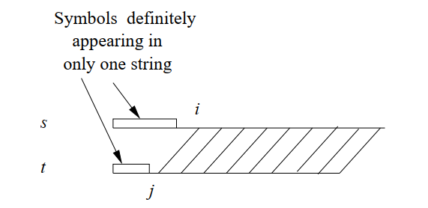
6. Using Position Information
Thus, if we find that the ith symbol of s is x, then we need look in the bucket (x, j) for certain small values of j.
The inequality j ≤ (Ls(1 − J) − i + 1 + J)/J is used to determine the upper bound on positions in t that need to be checked, ensuring the efficiency of the process.

Slide 12
6. Using Position Information
Example: s = “acdefghijk”, J = 0.9
Suppose i = 1. Then j ≤ (10 × 0.1 − 1 + 1 + 0.9)/0.9 = 2.11
Thus, j can be 1 or 2
Suppose i = 2. Then we require j ≤ (10 × 0.1 − 2 + 1 + 0.9)/0.9 = 1
We only need to look in the buckets for (a, 1), (a, 2), and (c, 1) in string t instead of looking to all buckets (a, j) and (c, j) for any j.

Slide 13
7. Using Position and Length in Indexes
The efficiency of comparing strings can be improved by incorporating both position and suffix length into index buckets.
Suppose: i, j: position of s, t prefix
p, q: suffix length s, t
x: the ith symbol of the string s
We must look in those buckets (x, j, q) of t

Slide 14
7. Using Position and Length in Indexes
When comparing suffix lengths of two strings, two cases are considered:
p ≥ q: the maximum size of their intersection is q + 1
the minimum union size is Ls + j − 1
the Jaccard similarity is (q + 1) / (Ls + j − 1)
→ (q + 1) / (Ls + j − 1) ≥ J
p < q: the intersection size remains Ls − i + 1
the union size increases to i + j − 1 + q
The Jaccard similarity is (Ls − i + 1) / (i + j − 1 + q)
→ (Ls − i + 1) / (i + j − 1 + q) ≥ J
These formulas help optimize the comparison process by considering suffix length and eliminating non-matching candidates earlier.

Slide 15
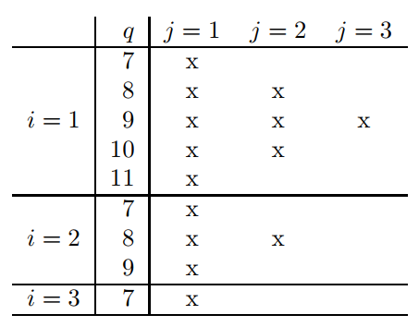
7. Using Position and Length in Indexes
Example: s = “acdefghijk”, J = 0.8
i ≤ [(1 − J)×Ls] + 1 → i = 1, 2, 3
j ≤ (Ls(1 − J) − i + 1 + J)/J → j
p ≥ q: (q + 1)/(Ls + j − 1) ≥ J → q
p < p: (Ls − i + 1)/(i + j − 1 + q) ≥ J

Slide 16
Thank you for your listening!

